Slide 1
Specific Learning Disability Student Sample
2/11/19
Pd:1

Slide 2
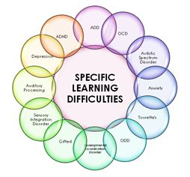
Specific Learning Disability and ADHD

Slide 3
Dictionary Definition
My Definition
Interferes with a student’s ability to listen,think,speak,write,spell or mathematical calculations students with a specific learning disability may struggle with reading,writing,math
Have trouble focusing on specific things and also struggle with some things as well

Slide 4
Specific Challenges I have:
Taking tests
Anxiety
Math and Reading

Slide 5
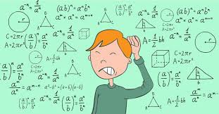
How does your disability affect you?
My disability affects me by having trouble focusing in classes
I get anxious when
being rushed or when I don’t understand something

Slide 6
I cope with my disability by taking a breather when I start feeling stressed out and taking medicine to help me think and learn a little bit easier
I do a lot of studying at home because I know it takes me longer to learn

Slide 7
Famous people with a disability
Michael Phelps(ADHD)
Ty Pennington(ADHD)
Howie Mandel(ADHD and OCD)

Slide 8
What is one thing you never knew about this disability that you learned from doing this research?
I never knew that ADHD symptoms can look different in boys and girls and that so many people are just like me!

